Slide 1
Welcome to my presentation
Presentation Title: Calculate Gender Development Index of Czech Republic and compare with Bangladesh Presenter Name :Md. Abu Zafor Student Id:2020-2-60-158 Course code and name:GEN214 Section:01
Course Instructor : Md. Sanaul Haque Mondal
Assistant Professor Department of Social Relations

Slide 2
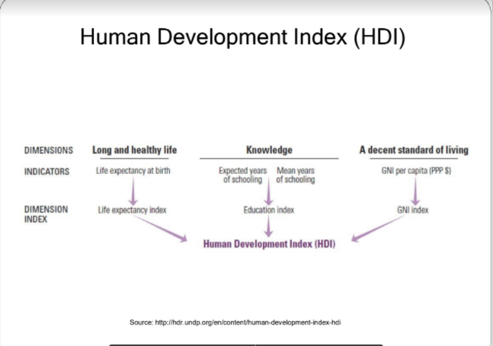
Human Development Index

Slide 3
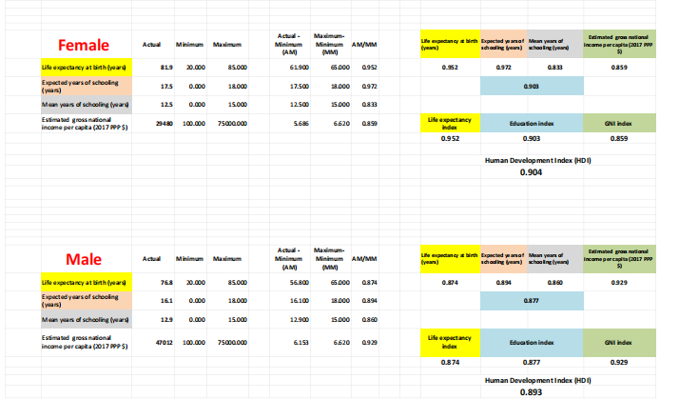
Czech Republic HDI(Male and Female)

Slide 4
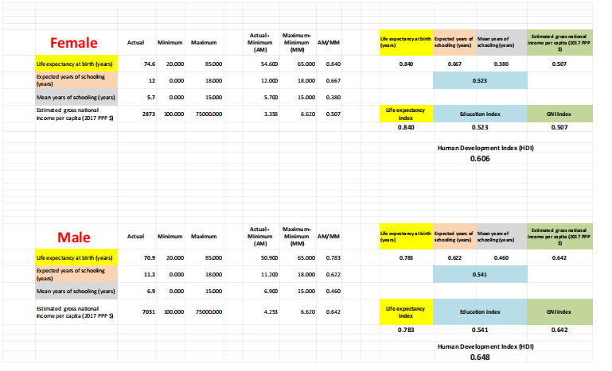
Bangladesh HDI(Male and Female)

Slide 5
HDI & gender gap difference between Czech Republic and Bangladesh
Bangladesh |  |  | Czech Republic
 | Female | Male | Female | Male
Life expectancy | 0.840 | 0.783 | 0.952 | 0.874
Education index | 0.523 | 0.541 | 0.903 | 0.877
GNI index | 0.507 | 0.642 | 0.859 | 0.929
HDI index | 0.606 | 0.648 | 0.904 | 0.893
Gender gap | 0.042 | 0.011

Slide 6
Thank You Everyone

